Slide 1
EIGRP
CCNA Exploration Semester 2
Chapter 9

Slide 2
Topics
Background and history of EIGRP
Features and operation of EIGRP
Basic EIGRP configuration
EIGRP’s composite metric
Concepts and operation of DUAL
More EIGRP configuration commands

Slide 3
Routing protocols
Interior
Exterior
Distance vector
Link state
RIP v1
RIP v2
IGRP
EIGRP
OSPF
IS-IS
EGP
BGP

Slide 4
EIGRP
Cisco proprietary – only on Cisco routers
Developed from the older IGRP (classful)
EIGRP is classless, supports VLSM, CIDR
Distance vector
But has some features more typical of link state
Has a composite metric

Slide 5
EIGRP atypical features
Reliable Transport Protocol (RTP)
Bounded Updates
Diffusing Update Algorithm (DUAL)
Establishing Adjacencies
Neighbor and Topology Tables

Slide 6
RIP, IGRP, EIGRP
RIP is a typical distance vector routing protocol using hop count as metric, max 15.
IGRP was introduced to have a better metric and not be restricted to 15 hops. It is a typical distance vector routing protocol, and classful.
EIGRP was introduced to be classless and with other enhancements for better performance.

Slide 7
IGRP EIGRP
Bellman-Ford algorithm
Ages out routing entries
Sends periodic updates
Keeps best routes only
Slow convergence with holddown timers
Diffusing Update Algorithm (DUAL)
Does not age out entries
No periodic updates
Keeps backup routes
Faster convergence, no holddown timers

Slide 8
Faster convergence
Holddown timers slow down convergence but are needed to avoid routing loops. Loops can occur using the Bellman-Ford algorithm
EIGRP uses DUAL which is unlikely to produce routing loops. Therefore it does not need to rely on holddown timers and can converge more quickly.

Slide 9
Encapsulation
Frame header
IP packet header
EIGRP packet header
Type/ length/ value data
If Ethernet, destination MAC address multicast
01-00-5E-00-00-0A.
Opcode
AS number
EIGRP Parameters,
IP Internal Routes,
IP External Routes.
Protocol field 88
destination address multicast 224.0.0.10.

Slide 10
EIGRP packet header
EIGRP packet header
Opcode specifies packet type:
Update, Query, Reply, Hello
Autonomous system (AS) number specifies the EIGRP process. Several can run at the same time.
Other fields allow for reliability if needed.

Slide 11
EIGRP TLV field
Type/ length/ value data
Values needed for calculating metric
K1 value, default 1, weighting for bandwidth
K2 value, default 0, weighting for
K3 value, default 1, weighting for delay
K4 value, default 0, weighting for
K5 value, default 0, weighting for

Slide 12
EIGRP TLV field
Type/ length/ value data
Hold time:
The number of seconds a router should wait for a hello message before considering that a neighbour router is down.

Slide 13
EIGRP TLV field
Type/ length/ value data
Hold time:
The number of seconds a router should wait for a hello message before considering that a neighbour router is down.

Slide 14
Internal routes
Type/ length/ value data
Internal routes originate within the AS.
Their messages include
  metric information:
  bandwidth, delay, load, reliability
  prefix length and network address
  Next hop address

Slide 15
External routes
Type/ length/ value data
External routes originate elsewhere and are imported. (Static, other protocol, other AS)
Their messages include all the internal route information.
Plus extra fields used to track the source of the information.

Slide 16
Metrics
Bandwidth is the lowest configured bandwidth on any interface on the route.
It is not an actual measured value.
You should always configure a bandwidth value on an interface when using EIGRP, otherwise a default is used.

Slide 17
Metrics
Delay is calculated as the sum of delays from source to destination in units of 10 microseconds.

Slide 18
Network layer protocols
EIGRP can support more than one network layer protocol, e.g. IP, IPX, Appletalk.
It has protocol dependent modules to support the different network layer protocols.
It keeps separate routing tables, neighbor tables and topology tables for the different network layer protocols.
The main EIGRP software is independent of the network layer protocol.

Slide 19
Reliable Transport Protocol
RTP is used instead of TCP and UDP.
It can provide reliability like TCP by means of acknowledgements.
It can send some packets unreliably like UDP.
TCP and UDP are not used because that would tie EIGRP to the TCP/IP suite, and it was designed to be independent.

Slide 20
Protocol dependent modules
IPX PDM
IP PDM
Appletalk PDM
+
+
+
DUAL
DUAL
DUAL
Neighbour discovery
Neighbour discovery
Neighbour discovery
RTP
RTP
RTP
IPX encapsulation
IP encapsulation
Appletalk
encapsulation

Slide 21

Hello packets
Used by EIGRP to discover neighbours
Used to form adjacencies with neighbours.
Multicasts
Unreliable delivery
Hello
Hello

Slide 22
Update packets
Used to propagate routing information.
No periodic updates.
Sent only when necessary.
Include only required information
Sent only to those routers that require it.
Reliable delivery.
Multicast if to several routers, unicast if to one router.

Slide 23
Update packets
EIGRP updates are sent only when a route changes.
EIGRP updates are partial. They include only information about the changed route.
EIGRP updates are bounded. They go only to routers that are affected by the change.
This keeps updates small and saves bandwidth.

Slide 24
Acknowledgement (ACK) packets
Sent when reliable delivery is used by RTP.
Sent in response to update packets.
Unreliable delivery
Unicast
Update (reliable)
ACK (unreliable)

Slide 25
Query packet
Used when searching for a network
E.g. a route goes down. Is there another route?
Uses reliable delivery so requires ACK
Multicast or unicast
All neighbours must reply
Query (reliable)
ACK (unreliable)

Slide 26
Reply packet
Sent in response to a query from a neighbour.
Sent reliably so requires ACK.
Unicast
Query (reliable)
ACK (unreliable)
Reply (reliable)
ACK (unreliable)

Slide 27
Summary of message types
 | Unicast | Multicast | Either
Reliable | Reply |  | Update Query
Unreliable | ACK | Hello

Slide 28
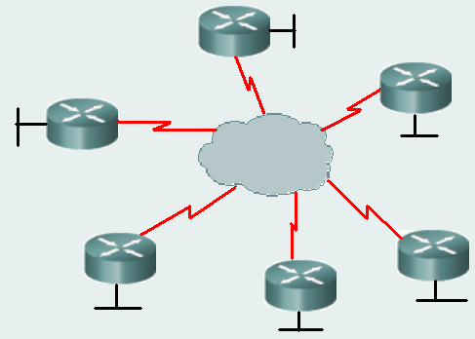
NBMA network
NonBroadcast MultiAccess network (NBMA)
Examples are X.25, Frame Relay, and ATM
More than two devices on the same subnet.
Ethernet is not NBMA.
It is multiaccess, but it
allows broadcasts.
Frame relay

Slide 29
Neighbour
Router on a shared network, running EIGRP.
Discover through Hello messages sent every 5 sec (default) on most networks, but every 60 sec on slow NBMA networks.
Hellos received = neighbour still up, its routes are still valid.
No Hello? Wait for holdtime (3 hello intervals) and if still no Hello then neighbour is down.

Slide 30
Route source | Administrative distance
Connected | 0
Static | 1
EIGRP summary | 5
External BGP | 20
Internal EIGRP | 90
IGRP | 100
OSPF | 110
IS-IS | 115
RIP | 120
External EIGRP | 170
Internal BGP | 200

Slide 31
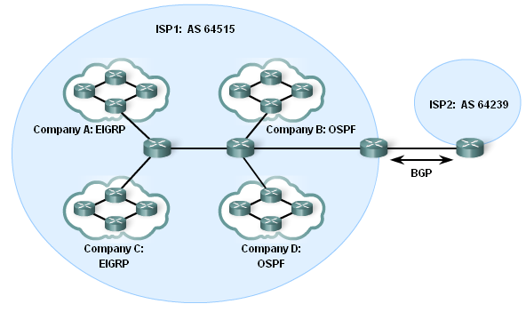
Autonomous systems
ISPs
Internet Backbone providers
Large organisations connecting directly

Slide 32
EIGRP “AS number”
EIGRP uses an “autonomous system number” in its configuration.
This is not a real AS number.
It is a process number to distinguish different EIGRP processes.
Neighbours must use the same AS number.
OSPF also uses process numbers.

Slide 33
Configuring EIGRP
AS number
Router(config)#router eigrp 1
Router(config-router)#network 172.16.0.0
Router(config-router)#network 192.168.1.0
Network commands have the same purpose as for RIP.
The classful network address is used here.

Slide 34
Configuring EIGRP with mask
Router(config-router)#network 172.16.0.0
All subnets of 172.16.0.0 will be included.
To specify certain subnets only:
network 172.16.3.0 0.0.0.255
Wildcard mask

Slide 35
Subnet mask, wildcard mask
255.255.255.255
255.255.255. 0
0 . 0 . 0 .255
255.255.255.255
255.255.255.240
0 . 0 . 0 . 15
-
Subnet mask
Wildcard mask
-
255.255.255.255
255.255.255.252
0 . 0 . 0 . 3
255.255.255.255
255.255.248. 0
0 . 0 . 7 .255
-
Subnet mask
Wildcard mask
-
Wildcard mask is the inverse of the subnet mask

Slide 36
Subnet mask, wildcard mask
Some router IOS versions let you enter the subnet mask and they convert it to the wildcard mask for you.
network 172.16.3.0 255.255.255.0
Output from show run includes
router eigrp 1
network 172.16.3.0 0.0.0.255

Slide 37
Finding a neighbour
If a router is configured for EIGRP and exchanges Hello packets with another router that is configured for EIGRP using the same AS number, then they become adjacent.
%DUAL-5-NBRCHANGE: IP-EIGRP 1: Neighbor 172.16.3.1 (Serial0/0) is up: new adjacency

Slide 38
Show ip eigrp neighbors
IP EIGRP neighbors for process 1
H | Address | Interface | Hold sec | Uptime | SRTT (ms) | RTP | Q cnt | Seq type num
1 | 192.168.1.1 | Se0/0 | 10 | 00:01:41 | 20 | 200 | 0 | 7
0 | 172.16.1.1 | Se0/1 | 10 | 00:08:24 | 25 | 200 | 0 | 28
Order in which neighbours were learned

Slide 39
Show ip eigrp neighbors
IP EIGRP neighbors for process 1
H | Address | Interface | Hold sec | Uptime | SRTT (ms) | RTP | Q cnt | Seq type num
1 | 192.168.1.1 | Se0/0 | 10 | 00:01:41 | 20 | 200 | 0 | 7
0 | 172.16.1.1 | Se0/1 | 10 | 00:08:24 | 25 | 200 | 0 | 28
Address of neighbour

Slide 40
Show ip eigrp neighbors
IP EIGRP neighbors for process 1
H | Address | Interface | Hold sec | Uptime | SRTT (ms) | RTP | Q cnt | Seq type num
1 | 192.168.1.1 | Se0/0 | 10 | 00:01:41 | 20 | 200 | 0 | 7
0 | 172.16.1.1 | Se0/1 | 10 | 00:08:24 | 25 | 200 | 0 | 28
Interface that connects to neighbour

Slide 41
Show ip eigrp neighbors
IP EIGRP neighbors for process 1
H | Address | Interface | Hold sec | Uptime | SRTT (ms) | RTP | Q cnt | Seq type num
1 | 192.168.1.1 | Se0/0 | 10 | 00:01:41 | 20 | 200 | 0 | 7
0 | 172.16.1.1 | Se0/1 | 10 | 00:08:24 | 25 | 200 | 0 | 28
Time remaining before neighbour is considered down. Set to maximum when Hello arrives.

Slide 42
Show ip eigrp neighbors
IP EIGRP neighbors for process 1
H | Address | Interface | Hold sec | Uptime | SRTT (ms) | RTP | Q cnt | Seq type num
1 | 192.168.1.1 | Se0/0 | 10 | 00:01:41 | 20 | 200 | 0 | 7
0 | 172.16.1.1 | Se0/1 | 10 | 00:08:24 | 25 | 200 | 0 | 28
How long neighbour has been adjacent.

Slide 43
Show ip eigrp neighbor
IP EIGRP neighbors for process 1
H | Address | Interface | Hold sec | Uptime | SRTT (ms) | RTP | Q cnt | Seq type num
1 | 192.168.1.1 | Se0/0 | 10 | 00:01:41 | 20 | 200 | 0 | 7
0 | 172.16.1.1 | Se0/1 | 10 | 00:08:24 | 25 | 200 | 0 | 28
Used in reliable transport
Tracks updates, queries etc

Slide 44
Show ip protocols
Details of EIGRP configuration
Networks being advertised
Sources of information

Slide 45
Show ip route
Output might include:
192.168.10.0/24 is variably subnetted, 3 subnets, 2 masks
D 192.168.10.0/24 is a summary, 00:03:50, Null0
C 192.168.10.4/30 is directly connected, Serial 0/1
D 192.168.10.8/30 [90/26818581] via 192.168.10.6,
00:02:43, Serial 0/1
Note that EIGRP routes are labelled D for DUAL
VLSM is supported

Slide 46
Null zero summary route
192.168.10.0/24 is variably subnetted, 3 subnets, 2 masks
D 192.168.10.0/24 is a summary, 00:04:13, Null0
D 192.168.10.4/30 [90/2681856] via 192.168.10.10, 00:03:05, Serial 0/1
C 192.168.10.8/30 is directly connected, Serial 0/1
The router has routes to some subnets of 192.168.10.0 so it puts in a parent route.
If autosummary is enabled then it also puts in a route sending 192.168.10.0/24 to Null0
Packets to unknown subnets are dropped even if a default route exists.

Slide 47
EIGRP metric
Bandwidth and delay are used by default.
Load and reliability can be used too.
metric =
[K1*bandwidth + K2*bandwidth + K3*delay] * K5
256 - load
Reliability + K4
If K1 = K3 = 1 and K2 = K4 = K5 = 0
metric =
(bandwidth + delay)

Slide 48
K values
Show ip protocols will show the K values.
EIGRP metric weight K1=1, K2=0, K3=1, K4=0, K5=0
Leave them alone unless there is a very good reason to change them.
Router(config-router)#metric weights tos k1 k2 k3 k4 k5
tos (type of service) must be 0

Slide 49
Metric values in use
Show interface:
MTU 1500 bytes, BW 1544 Kbit, DLY 20000 usec,
reliability 255/255, txload 1/255, rxload 1/255
usec means microseconds. It should be μsec but the μ symbol is not available.

Slide 50
Bandwidth
The actual bandwidth is NOT measured.
Most serial interfaces use the default T1 bandwidth value of 1544 Kbps (1.544 Mbps).
If this is not close to the actual bandwidth then change the bandwidth setting.
Router(config-if)#bandwidth 64
This does not change the bandwidth of the link.

Slide 51
Using bandwidth
Take the lowest bandwidth value in the path.
Calculate (10,000,000/bandwidth) * 256
This is the bandwidth part of the metric.
Just to confuse you, this is also called “bandwidth” in the formula:
metric = “bandwidth” + delay

Slide 52
Delay
Delay is a measure of the time it takes for a packet to traverse a route.
Delay is not measured dynamically.
Default values are used, e.g.
  Serial interfaces 20,000 microseconds
  FastEthernet interfaces 100 microseconds
The delay value can be changed.

Slide 53
Using delay
Find the delay value on every outgoing interface along the path.
Add up all these values.
Delay metric = (sum of delay/10)* 256
Just to confuse you, this is also called “delay” in the formula:
metric = “bandwidth” + “delay”

Slide 54
Example step 1
Metric to this network?
BW 1,024 Kbps
delay 20000
BW 100,000 Kbps
delay 100
Bandwidth metric = (10,000,000/1024)*256
Round 10,000,000/1024 to a whole number before multiplying by 256
Bandwidth metric = 2,499,840.

Slide 55
Example step 2
Metric to this network?
BW 1,024 Kbps
delay 20000
BW 100,000 Kbps
delay 100
Delay metric = (sum of delay/10)* 256
= (20100/10)*256
= 514560

Slide 56
Example step 3
Metric to this network?
BW 1,024 Kbps
delay 20000
BW 100,000 Kbps
delay 100
Bandwidth metric = 2,499,840
Delay metric = 514560
Bandwidth + delay = 3014400
This is the metric calculated by the router on the left.

Slide 57
Reliability and Load
Reliability is measured dynamically. It measures the frequency of errors and the probability that the link will fail.
255 is totally reliable, 0 is totally unreliable.
Load is measured dynamically. It shows the amount of traffic using the link.
1/255 is minimal load. 255/255 is fully saturated.
Both transmit and receive load are measured.

Slide 58
Aaaaaargh! Page 9.3.4
Default metric = [K1*bandwidth + K3*delay] * 256
Since K1 and K3 both equal 1,
The formula simplifies to bandwidth + delay
This is algebra, Jim, but not as we know it.
IGRP used bandwidth + delay
EIGRP multiplies by a factor of 256
Do we incorporate *256 into the bandwidth and delay values or not? We seem uncertain.

Slide 59
DUAL terminology
D 192.168.1.0/24 [90/3014400] via 192.168.10.10, 00:00:31, Serial0/0/1
Interface of successor router that provides the next hop on the best path.
Feasible distance: the metric of the best path.

Slide 60
DUAL terminology
Reported distance: the metric that a neighbour (closer to the destination) reports for a route. This is the neighbours feasible distance for the route.
destination
FD 3016960
RD 3014400
FD 3014400
RD 28160
FD 28160

Slide 61
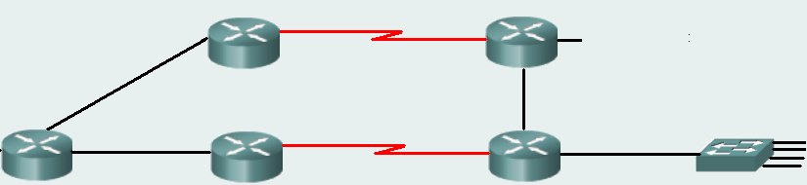
Feasibility condition (FC)
This condition is met if the reported distance (RD) to a network, learned from a neighbour, is less than the router’s own feasible distance.
3016960
30720
no
destination
yes
3016960
3014400
28160

Slide 62
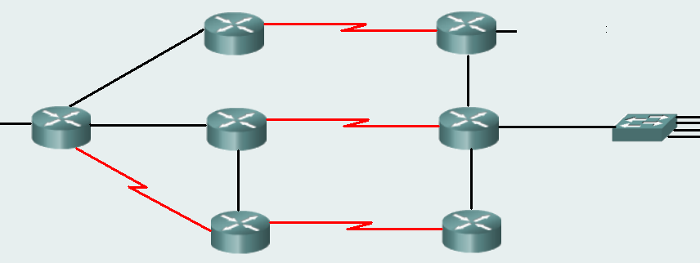
Feasibility condition
fails
1
3016960
30720
destination
1
1802240
1799680
28160
1
2
1797120
30720
Best route
Meets condition

Slide 63
Feasible successor (FS)
A feasible successor (FS) is a neighbour who has a path to the same network as the successor, and satisfies the feasibility condition.
This path should be loop-free and is kept as a backup path.

Slide 64
Feasible successor
fails
1
3016960
30720
destination
1
1802240
1799680
28160
1
2
1797120
30720
Best route
Meets condition, feasible successor, backup route

Slide 65
Topology table
P 192.168.1.0/24, 1 successors, FD is 3014400
via 192.168.10.10 (3014400/28160), Serial0/1
via 172.16.3.1 (41026560/2172416), Serial0/0
Lists all successors and feasible successors (backup routes)
Gives feasible distance and reported distance
Note that reported distance of backup route is less than feasible distance of successor.

Slide 66
Link down – use back-up route
1
3016960
30720
destination
1
1802240
3014400
28160
X
1
2
1797120
30720
Link down on old best route
Use backup route. Note changed metric.

Slide 67
Topology table – passive/active
P 192.168.1.0/24, 1 successors, FD is 3014400
via 192.168.10.10 (3014400/28160), Serial0/1
via 172.16.3.1 (41026560/2172416), Serial0/0
P is for passive. The route is stable, not being recalculated, therefore it can be used.
A means active. An active route is in the process of being recalculated by DUAL and cannot be used.

Slide 68
Show commands
show ip eigrp topology
for basic topology table
show ip eigrp topology 192.168.1.0
for full details of routes to 192.168.1.0 including metrics used and hop count
show ip eigrp topology all-links
for all known routes including routes that are not successors or feasible successors

Slide 69
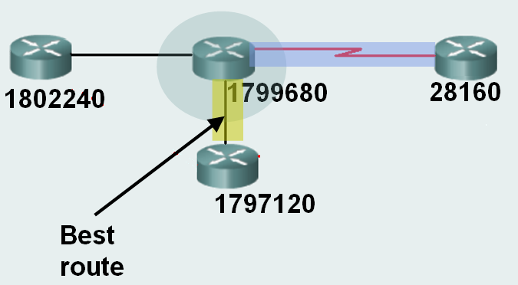
Distance vector limitation
Sees only its neighbours and what they report. Does not have picture of complete topology.
Not feasible successor. Loop?
Backup route

Slide 70
Distance vector limitation
Does not see loop-free path
1
3016960
30720
destination
1
1802240
1799680
28160
1
2
1797120
30720
Best route
Backup route.

Slide 71
Recalculation
Other loop-free routes can be found if necessary but DUAL has to do the calculation again on the basis of the latest information.
Successor route fails
No feasible successor (back-up)
Query neighbours for routes and get replies
Calculate and find new successor if one exists

Slide 72
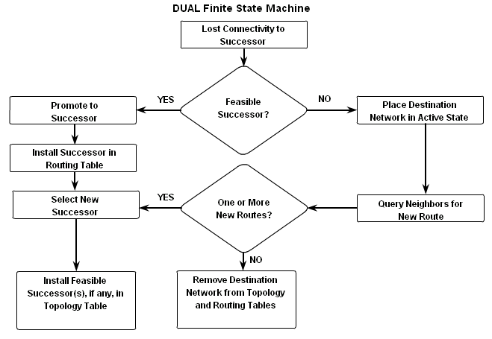
DUAL finite state machine
A set of possible states
Events that lead to the states
Events that result from the states
Think “flow chart”

Slide 73
debug eigrp fsm
Displays DUAL activity e.g. when a link goes down or comes up.
DUAL: Find FS for dest 192.168.1.0/24. FD is 3014400, RD is 3014400
DUAL: 192.168.10.10 metric 4294967295/4294967295
DUAL: 172.16.3.1 metric 41026560/2172416 found Dmin is 41026560
DUAL: Removing dest 192.168.1.0/24, nexthop 192.168.10.10
DUAL: RT installed 192.168.1.0/24 via 172.16.3.1

Slide 74
Manual summary routes
To summarise 192.168.4.0 and 192.168.5.0
Find the summary address 192.168.4.0/23
Go to each interface that should send the summary
Router(config-if)#ip summary-address eigrp 1 192.168.4.0 255.255.254.0
AS number
Summary address
Subnet mask

Slide 75
Static default route
R2(config-router)#redistribute static
This command allows static default routes to be included with EIGRP updates
These are external routes as shown in the routing tables.
D*EX 0.0.0.0/0 [170/3651840] via 192.168.10.6,
00:01:08, Serial0/1
Another option is ip default-network and give the address of a known network

Slide 76
Fine tuning
If EIGRP updates are using too much bandwidth, restrict them:
Router(config-if)#ip bandwidth-percent eigrp 1 40
By default the limit is 50%
AS number
Percent

Slide 77
Hello interval and hold time
These are configured on the interface and need not match the neighbour’s timers.
R2(config-if)#ip hello-interval eigrp 1 60
R2(config-if)#ip hold-time eigrp 1 180
Hold time must be greater than or equal to hello interval.
Values 1 to 65,535 are possible.
AS number
Seconds

Slide 78
Is it very complicated?
No. Basic EIGRP configuration is simple.
Router(config)#router eigrp 1
Router(config-router)#network 192.168.1.0
Router(config-router)#network 192.168.2.0

Slide 79
The End

